Slide 1
Fundamentals of Data Science
Ch 4: First steps in big data

Slide 2
This chapter covers:
Taking your first steps with two big data applications: Hadoop and Spark
Using Python to write big data jobs
Building an interactive dashboard that connects to data stored in a big data database

Slide 3
Distributing data storage and processing with frameworks
New big data technologies such as Hadoop and Spark make it much easier to work with and control a cluster of computers. Hadoop can scale up to thousands of computers, creating a cluster with petabytes of storage. This enables businesses to grasp the value of the massive amount of data available.

Slide 4
Hadoop: a framework for storing and processing large data sets
Apache Hadoop is a framework that simplifies working with a cluster of computers. It aims to be all of the following things and more:
Reliable—By automatically creating multiple copies of the data and redeploying processing logic in case of failure.
Fault tolerant—It detects faults and applies automatic recovery.
Scalable—Data and its processing are distributed over clusters of computers (horizontal scaling).
Portable—Installable on all kinds of hardware and operating systems. The core framework is composed of a distributed file system, a resource manager, and a system to run distributed programs. In practice it allows you to work with the distributed file system almost as easily as with the local file system of your home computer. But in the background, the data can be scattered among thousands of servers.

Slide 5
THE DIFFERENT COMPONENTS OF HADOOP
At the heart of Hadoop we find
A distributed file system (HDFS)
A method to execute programs on a massive scale (MapReduce)
A system to manage the cluster resources (YARN)
On top of that, an ecosystem of applications arose (figure 5.2), such as the databases Hive and HBase and frameworks for machine learning such as Mahout. We’ll use Hive in this chapter. Hive has a language based on the widely used SQL to interact with data stored inside the database

Slide 6
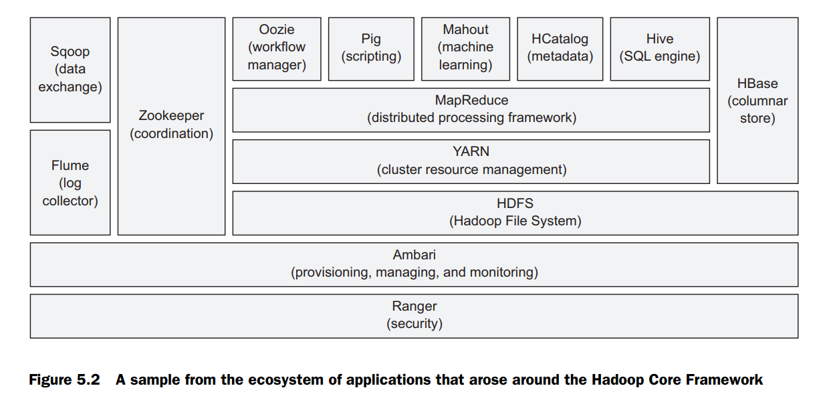

Slide 7
MAPREDUCE: HOW HADOOP ACHIEVES PARALLELISM
Hadoop uses a programming method called MapReduce to achieve parallelism. A MapReduce algorithm splits up the data, processes it in parallel, and then sorts, combines, and aggregates the results back together. However, the MapReduce algorithm isn’t well suited for interactive analysis or iterative programs because it writes the data to a disk in between each computational step. This is expensive when working with large data sets.

Slide 8
MAPREDUCE: HOW HADOOP ACHIEVES PARALLELISM
Let’s see how MapReduce would work on a small fictitious example. You’re the director of a toy company. Every toy has two colors, and when a client orders a toy from the web page, the web page puts an order file on Hadoop with the colors of the toy. Your task is to find out how many color units you need to prepare. You’ll use a MapReduce-style algorithm to count the colors. First let’s look at a simplified version in figure 5.3

Slide 9
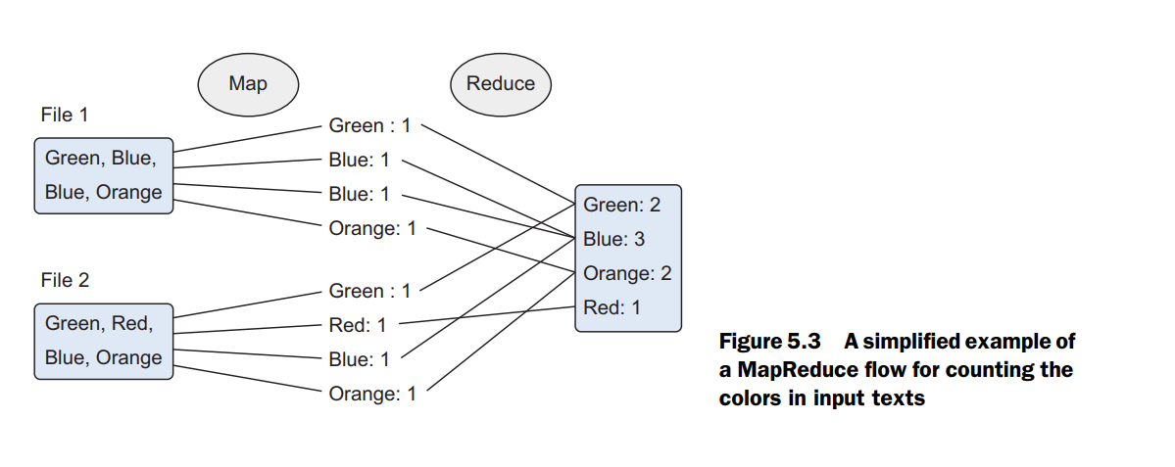
MAPREDUCE: HOW HADOOP ACHIEVES PARALLELISM

Slide 10
MAPREDUCE: HOW HADOOP ACHIEVES PARALLELISM
As the name suggests, the process roughly boils down to two big phases:
Mapping phase—The documents are split up into key-value pairs. Until we reduce, we can have many duplicates.
Reduce phase—It’s not unlike a SQL “group by.” The different unique occurrences are grouped together, and depending on the reducing function, a different result can be created. Here we wanted a count per color, so that’s what the reduce function returns.
In reality it’s a bit more complicated than this though.

Slide 11
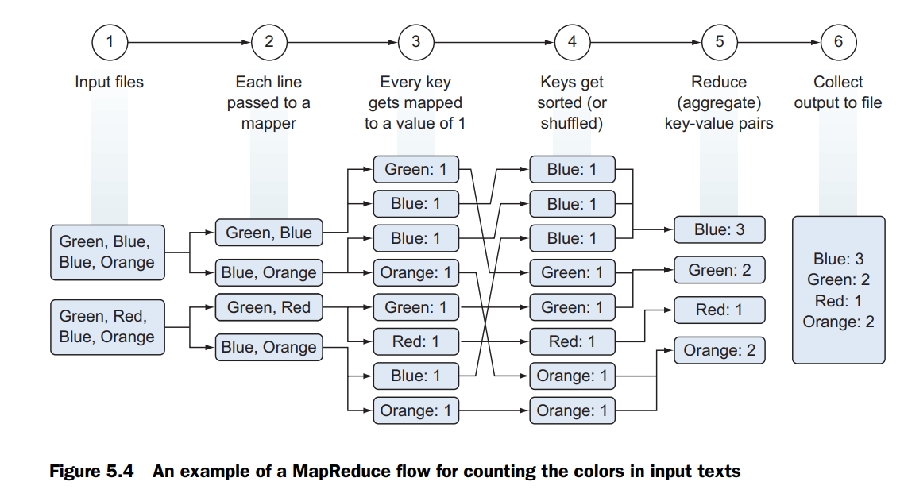
MAPREDUCE: HOW HADOOP ACHIEVES PARALLELISM
In reality it’s a bit more complicated than this though.

Slide 12
Spark: replacing MapReduce for better performance
Data scientists often do interactive analysis and rely on algorithms that are inherently iterative; it can take awhile until an algorithm converges to a solution. As this is a weak point of the MapReduce framework, we’ll introduce the Spark Framework to overcome it. Spark improves the performance on such tasks by an order of magnitude

Slide 13
WHAT IS SPARK?
Spark is a cluster computing framework similar to MapReduce. Spark, however, doesn’t handle the storage of files on the (distributed) file system itself, nor does it handle the resource management. For this it relies on systems such as the Hadoop File System, YARN, or Apache Mesos. Hadoop and Spark are thus complementary systems. For testing and development, you can even run Spark on your local system

Slide 14
HOW DOES SPARK SOLVE THE PROBLEMS OF MAPREDUCE?
While we oversimplify things a bit for the sake of clarity, Spark creates a kind of shared RAM memory between the computers of your cluster. This allows the different workers to share variables (and their state) and thus eliminates the need to write the intermediate results to disk. More technically and more correctly if you’re into that: Spark uses Resilient Distributed Datasets (RDD), which are a distributed memory abstraction that lets programmers perform in-memory computations on large clusters in a faulttolerant way. Because it’s an in-memory system, it avoids costly disk operations.

Slide 15
THE DIFFERENT COMPONENTS OF THE SPARK ECOSYSTEM
Spark core provides a NoSQL environment well suited for interactive, exploratory analysis. Spark can be run in batch and interactive mode and supports Python.
Spark has four other large components, as listed below and depicted in figure 5.5.
Spark streaming is a tool for real-time analysis.
Spark SQL provides a SQL interface to work with Spark.
MLLib is a tool for machine learning inside the Spark framework.
GraphX is a graph database for Spark.

Slide 16
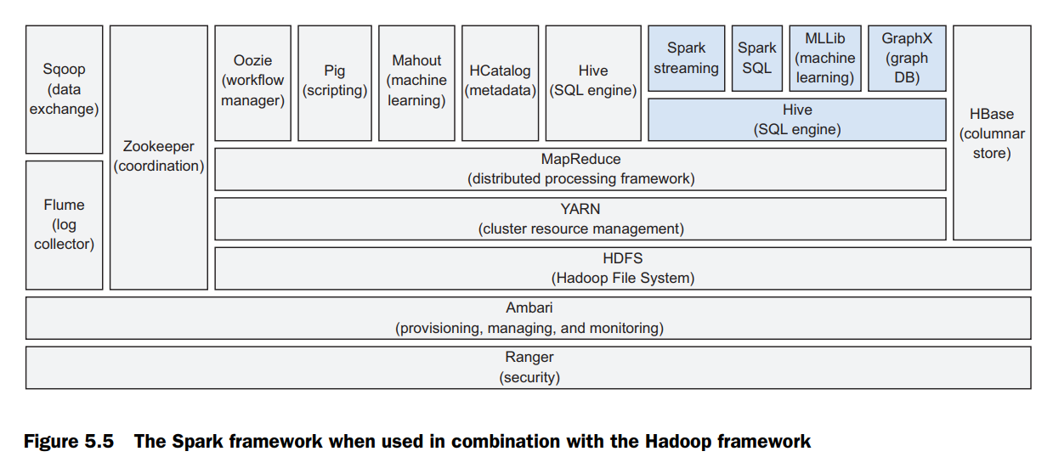
THE DIFFERENT COMPONENTS OF THE SPARK ECOSYSTEM

